Slide 1
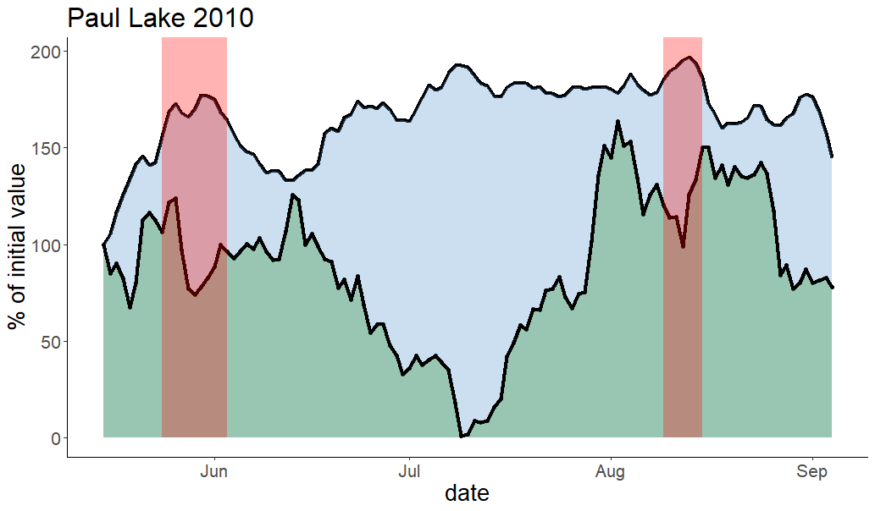
Temperature
Chlorophyll
Heatwaves

